Slide 1



CRISIS-PULSE
prepared by,
Mistry Utsav Ashok
Vedant Nirav Hingu
Jagad Prachi Manishbhai
Vishvkarma Nikhil Rajeshbhai
Rathore Sarthaksingh Dinesh

Slide 2

WHAT WE DO:
Crisis Pulse is an AI-powered disaster management platform that helps communities stay safe during natural disasters.
01 | 02 | 03 | 04 | 05
Predict Disasters | Send Instant Alerts | Connect Communities | Reward Help | Give Safety Tips

Slide 3

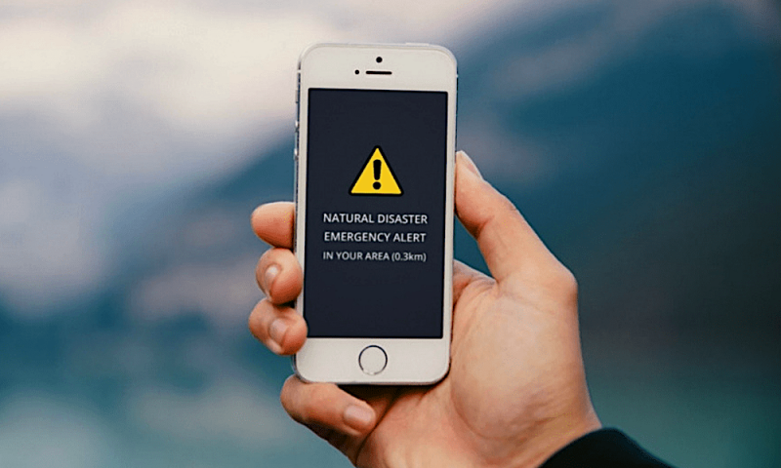

FEATURES
Predict floods, earthquakes, cyclones & droughts
Send real-time alerts and emergency messages
Different dashboards for volunteers, CRPF, and admins
Points & rewards for contributions
Weather updates + AI safety tips

Slide 4



FUTURE SCOPE
Faster warnings - more lives saved
Stronger community support
Better disaster data & insights
Future: IoT sensors, govt data, mobile app

Slide 5


THANK YOU!
Crisis Pulse – AI that saves lives during disasters

